Slide 1

COOPERATIVE PROVABLE DATA POSSESSION FOR INTEGRITY VERIFICATION IN MULTI-CLOUD STORAGE
Major Project Final Review Seminar
By
B. PADMA PRIYA (10R11A0505)
D. NAVEEN KANTH (10R11A0510)
B. KIRTHI (10R11A0526)
K. KAUSHIK (10R11A0527)
Under the guidance of M.ASHWINI (Associate Professor) Department of Computer Science and Engineering
GEETHANJALI COLLEGE OF ENGINEERING & TECHNOLOGY (Affiliated to JNTU-HYD) Cheeryal(V), Keesara(M), R.R. Dist. Hyderabad-501301,A.P. Year : 20013-2014

Slide 2
INTRODUCTION
Provable data possession (PDP) is a technique for ensuring the integrity of data in storage outsourcing.
In this project we address the construction of an efficient PDP scheme for distributed cloud storage to support the scalability of service and data migration in which we consider the existence of multiple cloud service providers to cooperatively store and maintain the clients’ data.
This project presents a cooperative PDP (CPDP) scheme based on homomorphic verifiable response and hash index hierarchy.

Slide 3
The security of this scheme is proved based on multi-proved zero-knowledge proof system, which can satisfy completeness, knowledge soundness, and zero-knowledge properties.
Performance optimization mechanisms are articulated, and in particular, this project presents an efficient method for selecting optimal parameter values to minimize the computation costs of clients and storage service providers.
This introduces lower computation and communication overheads in comparison with non-cooperative approaches.

Slide 4
MODULES
MULTI CLOUD STORAGE
COOPERATIVE PDP
DATA INTEGRITY
THIRD PARTY AUDITOR
CLOUD USER

Slide 5
MULTI-CLOUD STORAGE
Distributed computing is used to refer to any large collaboration in which many individual personal computer owners allow some of their computer's processing time to be put at the service of a large problem.
In this system each cloud admin consists of data blocks, the cloud user uploads the data into multi cloud.

Slide 6
Cloud computing environment is constructed based on open architectures and interfaces, it has the capability to incorporate multiple internal and/or external cloud services together to provide high interoperability.
Such a distributed cloud environment is called multi-Cloud .A multi-cloud allows clients to easily access his/her resources remotely through interfaces.

Slide 7
COOPERATIVE PDP
Cooperative PDP (CPDP) schemes adopt zero-knowledge property and three-layered index hierarchy, respectively.
Efficient methods for selecting the optimal number of sectors in each block to minimize the computation costs of clients and storage service providers are adopted.
Cooperative PDP (CPDP) scheme doesn’t compromise data privacy by using modern cryptographic techniques.

Slide 8
DATA INTEGRITY
Data Integrity is very important for database operations, data warehousing and business intelligence in general.
Data Integrity ensures that the data is of high quality, correct, consistent and accessible.

Slide 9
TRUSTED THIRD PARTY
Trusted Third Party (TTP) is the one who is trusted to store verification parameters and offer public query services for these parameters.
In this system the Trusted Third Party can view the user data blocks and upload them to the distributed cloud. If any modification is tried by the cloud owner, an alert is send to the Trusted Third Party.

Slide 10
CLOUD USER
The Cloud User is the one who has a large amount of data to be stored in multiple clouds and have the permissions to access and manipulate the stored data.
The User’s Data is converted into data blocks. The data blocks are uploaded to the cloud. The TPA views the data blocks and Uploads them in multi cloud.
The user can update the uploaded data. If the user wants to download his files, the data in multi cloud is integrated and downloaded.

Slide 11
HARDWARE REQUIREMENTS
HARDWARE | REQUIREMENT
Processor | PENTIUM IV
Speed | 1.1 GHz
RAM | 256 MB ( min)
Hard Disk | 20 GB
Floppy Drive | 1.44 MB
Keyboard | Standard Windows Keyboard
Mouse | Two or Three Button Mouse
Monitor | SVGA

Slide 12
SOFTWARE REQUIREMENTS
SOFTWARE | REQUIREMENT
Operating System | Windows 95/98/2000/XP
Application Server | Tomcat 5.0/6.X
Front End | HTML, Java, JSP
Scripts | JavaScript
Server Side Script | Java Server Pages
Database | MySql
Database Connectivity | JDBC

Slide 13
EXISTING SYSTEM
There exists various tools and technologies for multi cloud, such as Platform VM Orchestrator, Vmware vSphere, and Ovirt.
These tools help cloud providers construct a distributed cloud storage platform for managing clients’ data. However, if such an important platform is vulnerable to security attacks, it would bring irretrievable losses to the clients.

Slide 14
For example, the confidential data in an enterprise may be illegally accessed through a remote interface provided by a multi-cloud, or relevant data and archives may be lost or tampered when they are stored into an uncertain storage pool outside the enterprise.
Therefore, it is indispensable for cloud service providers to provide security techniques for managing their storage services.

Slide 15
PROPOSED SYSTEM
To check the availability and integrity of outsourced data in cloud storages, researchers have proposed two basic approaches called Provable Data Possession and Proofs of Retrievability.
Ateniese Et Al first proposed the PDP model for ensuring possession of files on untrusted storages and provided an RSA-based scheme for a static case that achieves the communication cost.

Slide 16
They also proposed a publicly verifiable version, which allows anyone, not just the owner, to challenge the server for data possession.
They proposed a lightweight PDP scheme based on cryptographic hash function and symmetric key encryption, but the servers can deceive the owners by using previous metadata or responses due to the lack of randomness in the challenges.
The numbers of updates and challenges are limited and fixed in advance and users cannot perform block insertions anywhere.

Slide 17
JAVA TOOLS
J2EE
JSP
JDBC

Slide 18
J2EE
The platform provides an API and runtime environment for developing and running enterprise software, including network and web services, and other large-scale, multi-tiered, scalable, reliable, and secure network applications.
The platform incorporates a design based largely on modular components running on an application server.

Slide 19
JSP
Java Server Pages (JSP) is a technology that helps software developers create dynamically generated web pages based on HTML, XML, or other document types.
To deploy and run Java Server Pages, a compatible web server with a servlet container, such as Apache Tomcat or Jetty, is required.

Slide 20
JDBC
This technology is an API for the Java programming language that defines how a client may access a database.
It provides methods for querying and updating data in a database.
JDBC is oriented towards relational databases.
A JDBC-to-ODBC bridge enables connections to any ODBC-accessible data source in the JVM host environment.

Slide 21
UML DIAGRAMS
USE CASE DIAGRAM
CLASS DIAGRAM
SEQUENCE DIAGRAM
ACTIVITY DIAGRAM

Slide 22
USECASE DIAGRAM
A Use Case Model describes the proposed functionality of a new system. Use Case represents a discrete unit of interaction between a user (human or machine) and the system.
A Use Case description generally includes requirements, constraints, scenarios, general comments, notes and some additional attributes.

Slide 23
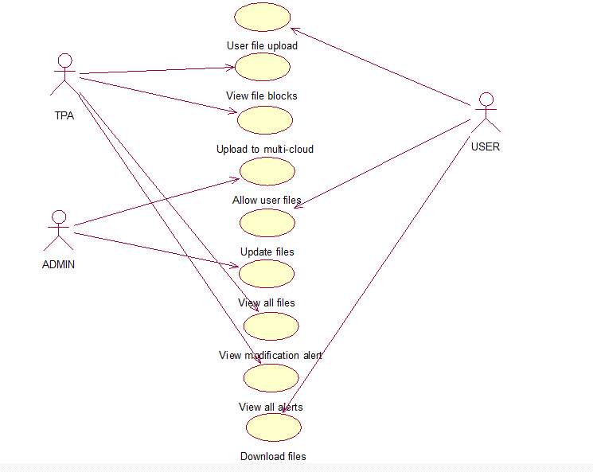

Slide 24
CLASS DIAGRAM
The class diagram is a static diagram. The class diagram shows a collection of classes, interfaces, associations, collaborations and constraints. It is also known as a structural diagram.
The purpose of the class diagram is to:
Analyze and design the static view
Describe responsibilities of a system.
Provide base for component and deployment diagrams.
Forward and reverse engineering.

Slide 25
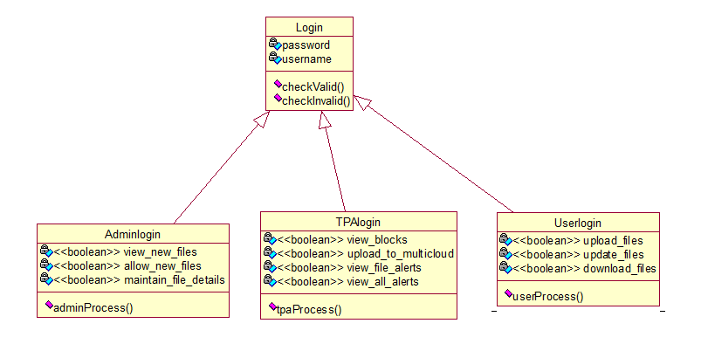

Slide 26
SEQUENCE DIAGRAM
Sequence diagrams provide a graphical representation of object interactions over time. These typically show a user or actor, and the objects and components they interact with in the execution of a use case.
The sequence diagram clearly shows the various actions that the modules perform in the application.

Slide 27
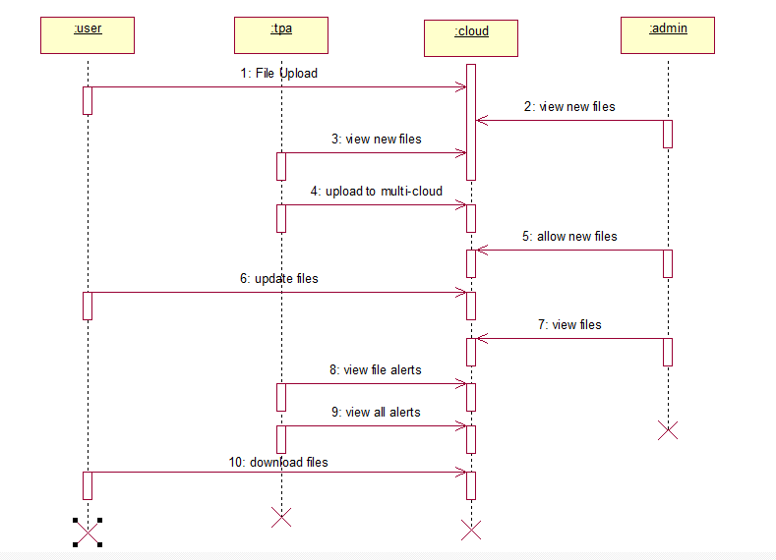

Slide 28
ACTIVITY DIAGRAM
Activity diagram is basically a flow chart that represents the flow form one activity to another activity. The activity can be described as an operation of the system.
This flow can be sequential, branched or concurrent. Activity diagrams deal with all types of flow control by using different elements like fork, join etc.
It captures the dynamic behavior of the system.
It does not show any message flow from one activity to another.

Slide 29
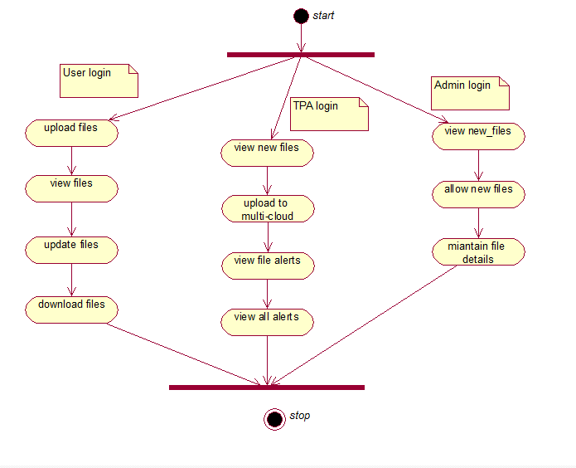

Slide 30
DATA FLOW DIAGRAMS
ADMIN
USER
TPA

Slide 31
DATA FLOW DIAGRAMS
A data flow diagram (DFD) is a graphical representation of the "flow" of data through an information system, modeling its process aspects.
A DFD shows what kinds of information will be input to and output from the system, where the data will come from and go to, and where the data will be stored.

Slide 32
ADMIN

Slide 33
USER

Slide 34
TPA

Slide 35
SOFTWARE TESTING
Software testing is an investigation conducted to provide stakeholders with information about the quality of the product or service under test.
Software testing can also provide an objective, independent view of the software to allow the business to appreciate and understand the risks of software implementation.
Test techniques include, but are not limited to the process of executing a program or application with the intent of finding software bugs (errors or other defects).

Slide 36
TEST CASES
S.No | Field | Input | Expected Result | Actual Result | Status Pass/Fail | Remarks
1 | Name | NULL | Enter Name | Enter Name | Pass | -
2 | Name | Ram | No Error | No Error | Pass | -
3 | Email | NULL | Enter Email ID | Enter Email ID | Pass | -
4 | Email | ram@gmail.com | No Error | No Error | Pass | -
5 | Mobile | NULL | Enter Valid Number | Enter Valid Number | Pass | -
6 | Mobile | Asdf | Enter Valid Number | Enter Valid Number | Pass | -
7 | Mobile | 9923667788 | No Error | No Error | Pass | -

Slide 37
SCREEN SHOTS
HOME PAGE
USER LOGIN PAGE
USER REGISTRATION PAGE
TPA LOGIN PAGE
ADMIN LOGIN PAGE
USER HOME PAGE
FILE UPLOAD PAGE

Slide 38
FILE UPDATE PAGE
TPA HOME PAGE
TPA ALL FILES PAGE
TPA FILE ALERT PAGE
TPA ALL FILE ALERTS PAGE
ADMIN HOME PAGE
ADMIN ALL FILES PAGE

Slide 39
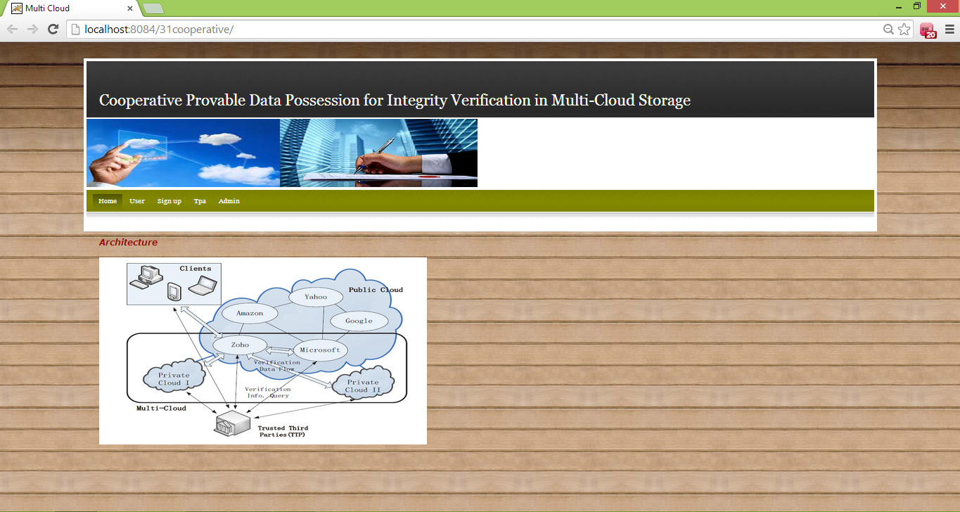
HOME PAGE

Slide 40
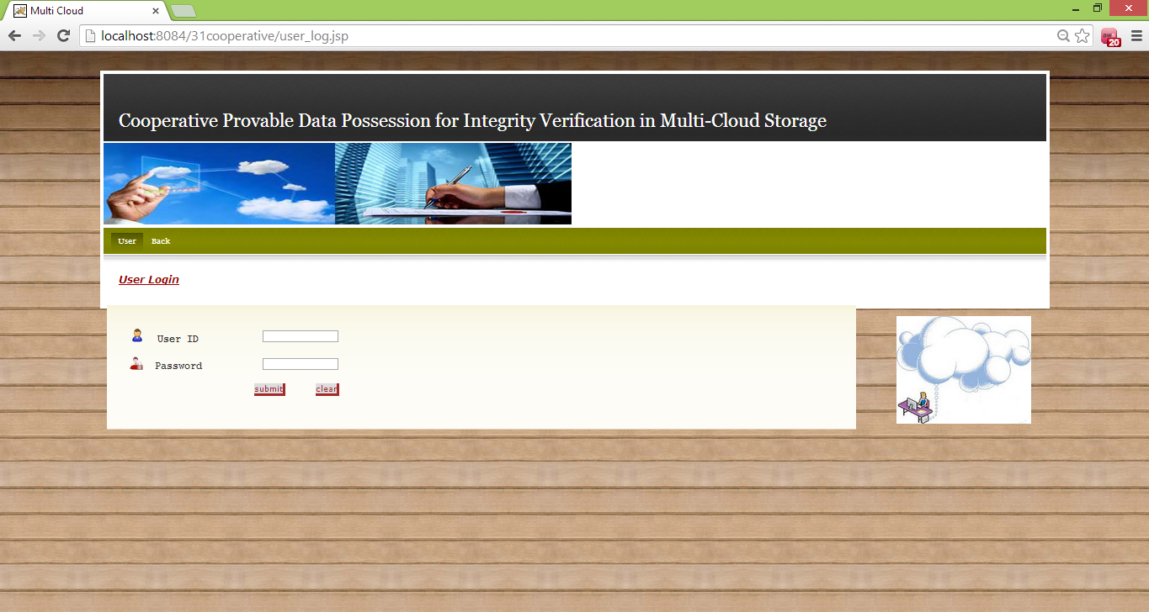
USER LOGIN PAGE

Slide 41
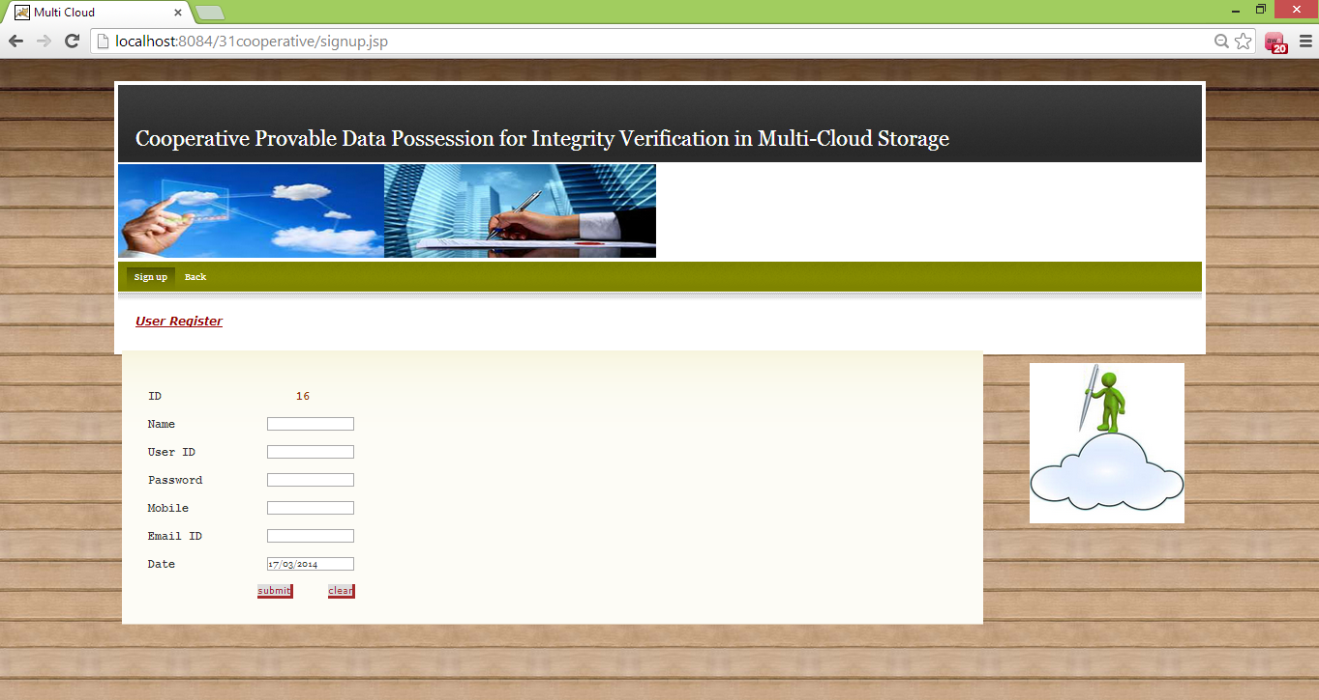
USER REGISTRATION PAGE

Slide 42
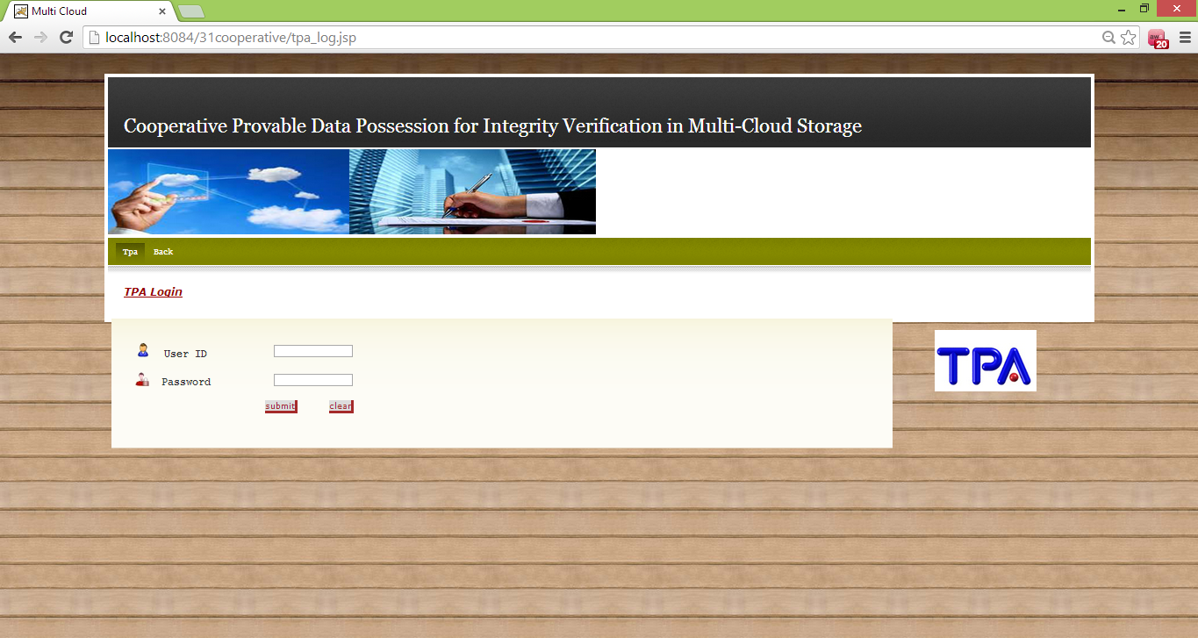
TPA LOGIN PAGE

Slide 43
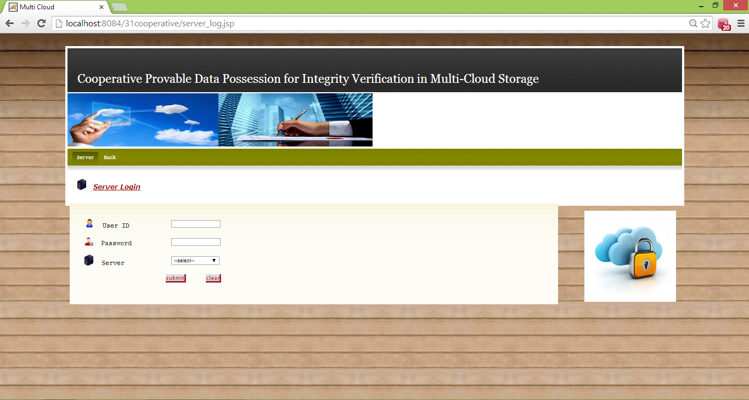
ADMIN LOGIN PAGE

Slide 44
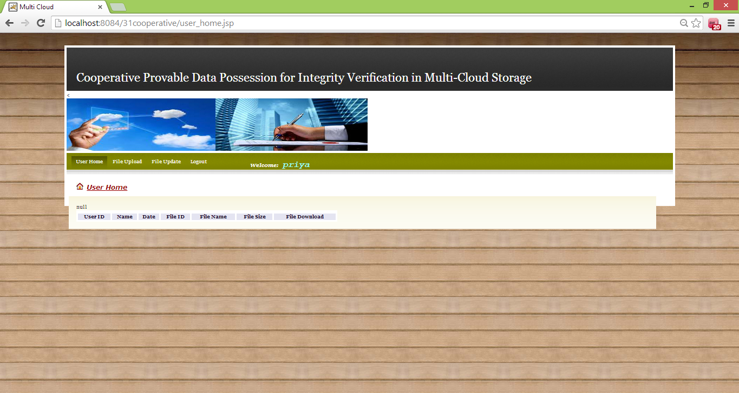
USER HOME PAGE

Slide 45
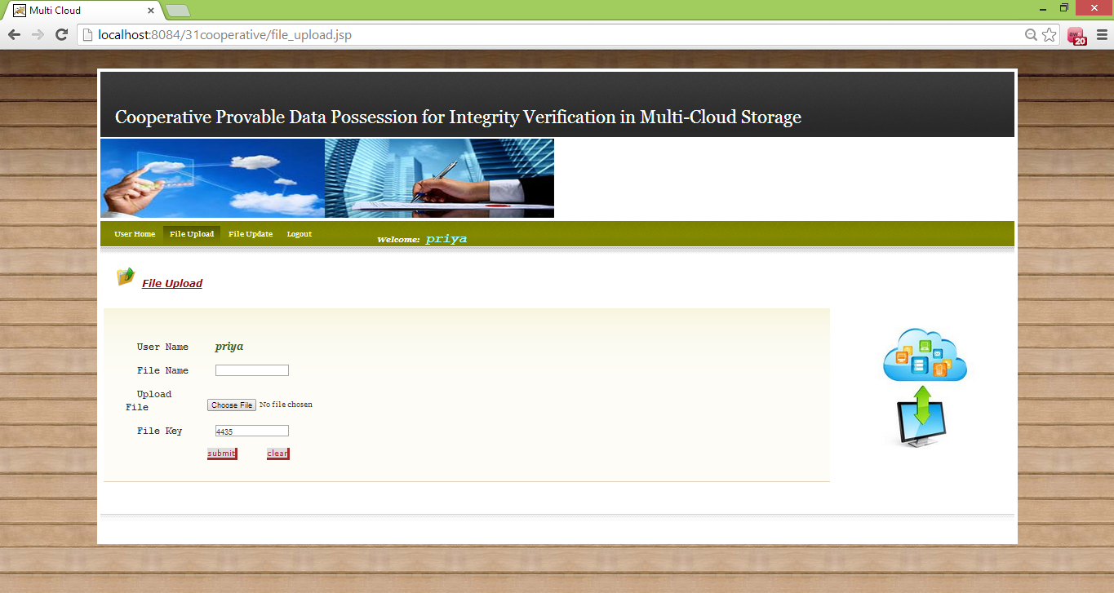
FILE UPLOAD PAGE

Slide 46
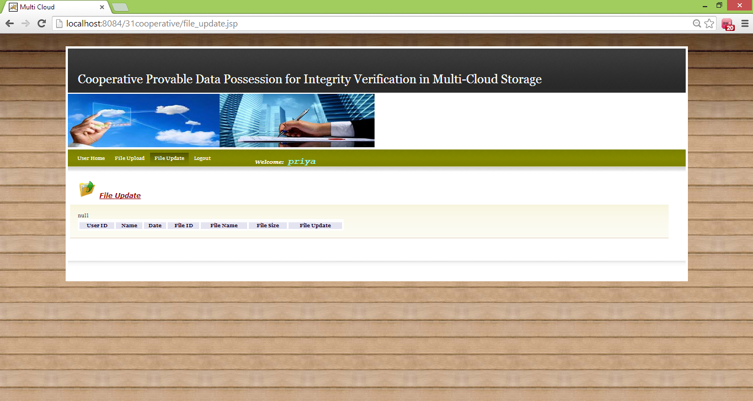
FILE UPDATE PAGE

Slide 47
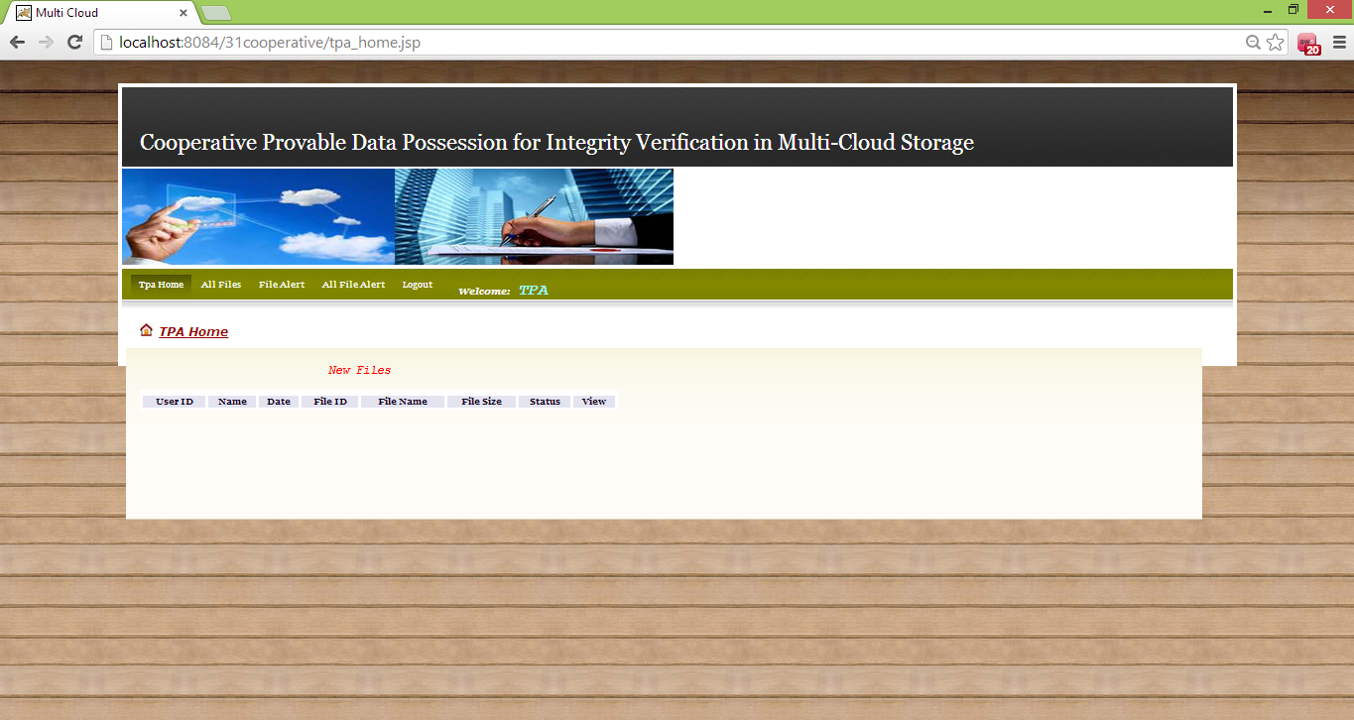
TPA HOME PAGE

Slide 48
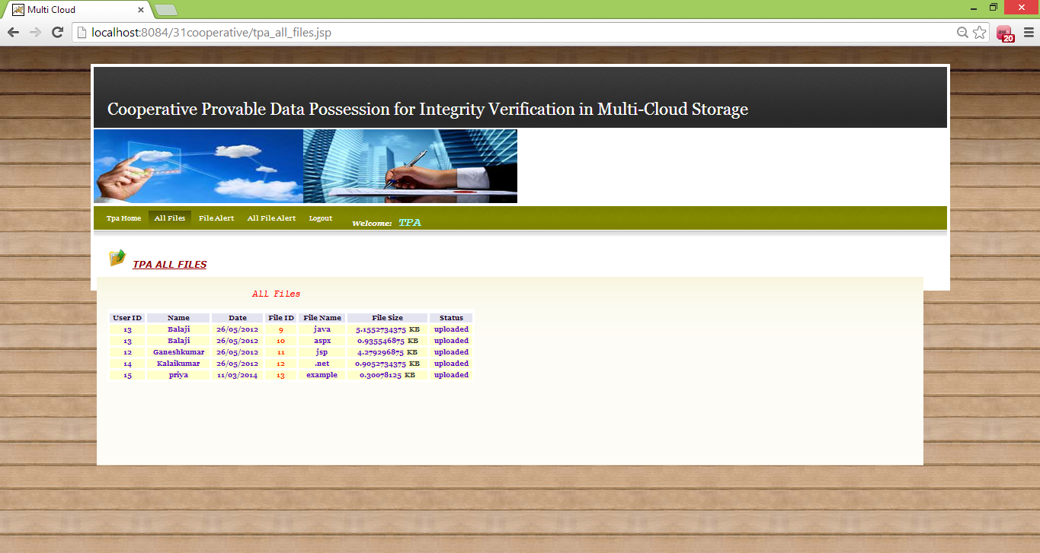
TPA ALL FILES PAGE

Slide 49
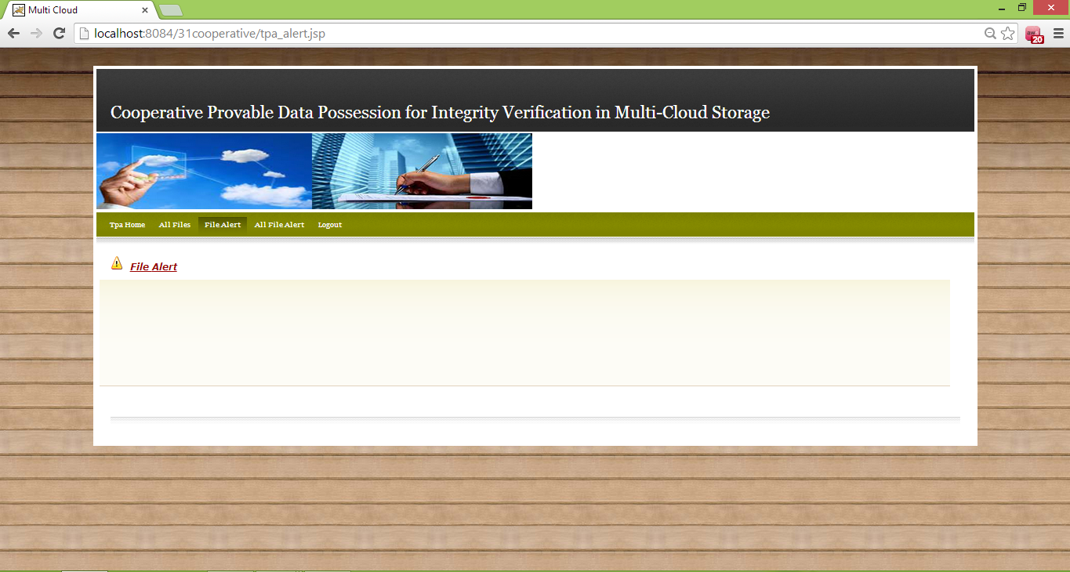
TPA FILE ALERT PAGE

Slide 50
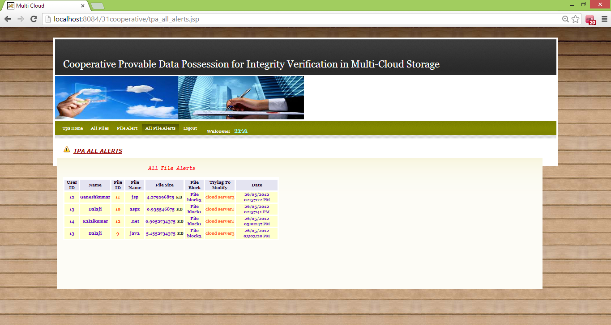
TPA ALL FILE ALERTS PAGE

Slide 51
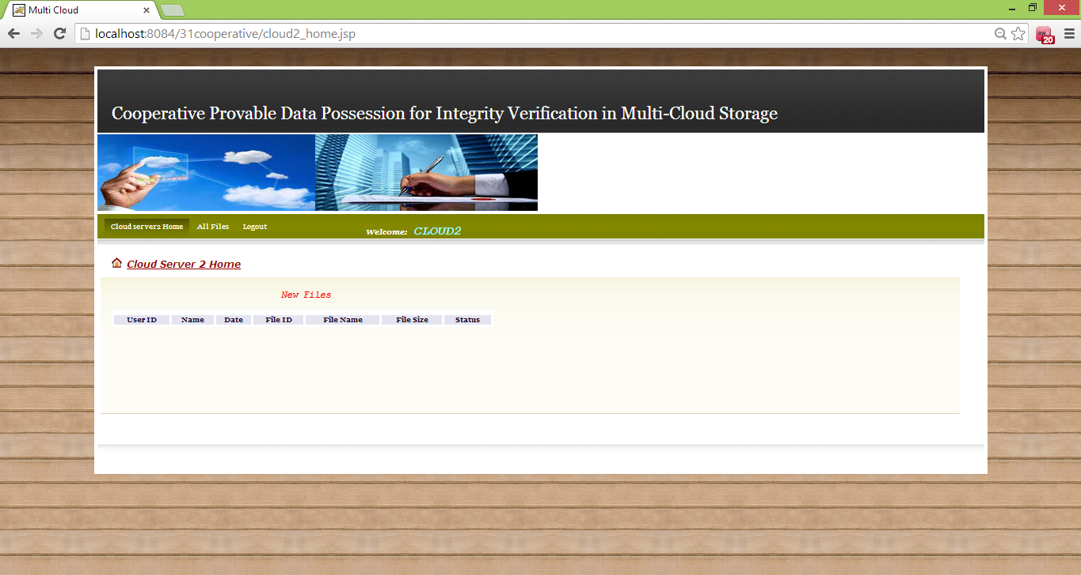
ADMIN HOME PAGE

Slide 52
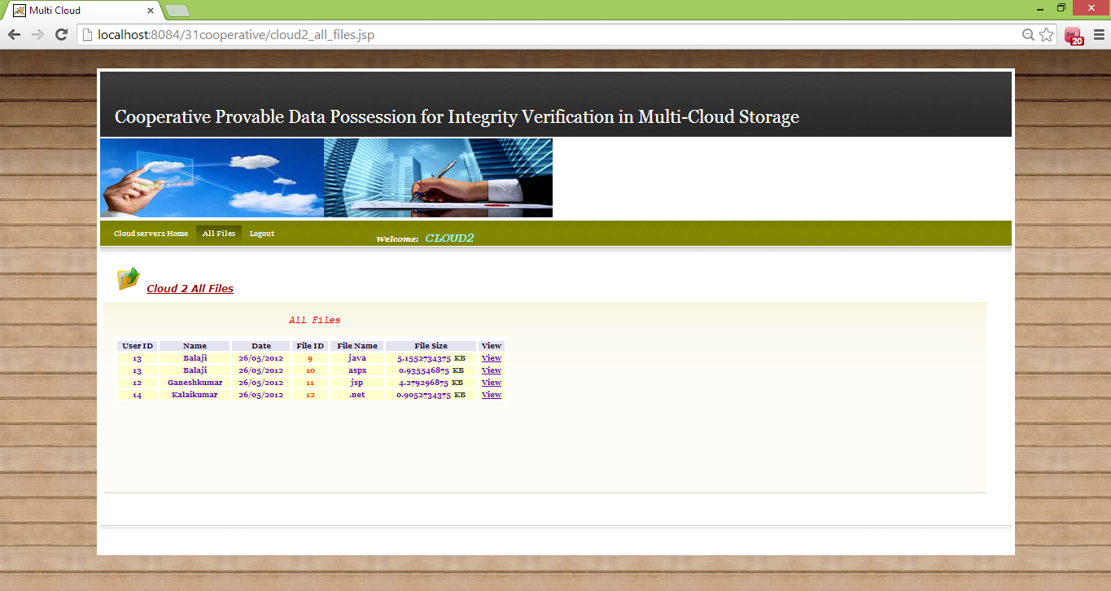
ADMIN ALL FILES PAGE

Slide 53
SAMPLE CODE
databasecon.java
packagedatabaseconnection;
importjava.sql.*;
public class databasecon
{
static Connection con;
public static Connection getconnection()
{
try

Slide 54
{
Class.forName("com.mysql.jdbc.Driver");
con=DriverManager.getConnection("jdbc:mysql://localhost:3306/multicloud","root","root");//multi-cloud
}
catch(Exception e)
{
System.out.println("class error");
}
return con;
}
}

Slide 55
CONCLUSION
An efficient PDP scheme for distributed cloud storage has been constructed.
Based on homomorphic verifiable response and hash index hierarchy, a cooperative PDP scheme to support dynamic scalability on multiple storage servers has been proposed.
It has been proved that CPDP provides all security properties required by zero-knowledge interactive proof system, so that it can resist various attacks even if it is deployed as a public audit service in clouds.

Slide 56
Furthermore, the probabilistic query and periodic verification are optimized to improve the audit performance.
Experiments clearly demonstrated that CPDP introduced a small amount of computation and communication overheads.
Therefore, CPDP can be treated as a new candidate for data integrity verification in outsourcing data storage systems.

Slide 57
As part of future work, we can extend the project to explore more effective CPDP constructions.
Finally, it is still a challenging problem for the generation of tags with the length irrelevant to the size of data blocks.
We can explore this issue to provide the support of variable-length block verification.

Slide 58
THANK YOU

